Slide 1
COMP-4150 ADVANCED AND PRACTICAL DB SYSTEMS
PART-B- PL/SQL-Functions, Procedures AND PACKAGES
Fall-2019

Slide 2
OUTLINE
SECTION-I - Introduction
PL/SQL Overview
Anonymus Blocks
Data Types
Variables
Comments & Constants
SECTION-II- Condition Control & LOOPS
IF statements
Case Statements
GO TO & NULL Statements
LOOPS (FOR, WHILE)
SECTION-III- Stored PROCEDURES and FUNCTIONS
Procedures
Functions
Cursor Variables
SECTION-III- CURSORS
PL/SQL Cursors
Cursor FOR LOOP
Cursor With Parameters

Slide 3
OUTLINE
SECTION-V-Packages
PL/SQL Packages
File Structure
SECTION-VI-Triggers
Statement Level
Row Level

Slide 4
SECTION-IV& V FUNCTIONS,PROCEDURES,PACKAGES
Procedures
Functions
Packages

Slide 5
PL/SQL PROCEDURE
A PL/SQL procedure is a reusable unit that encapsulates specific business logic of the application
A PL/SQL procedure is a named block stored as a schema object in the Oracle Database.
1 2 3 4 5 6 7 8 | CREATE [OR REPLACE ] PROCEDURE procedure_name (parameter_list) IS [declaration statements] BEGIN [execution statements] EXCEPTION [exception handler] END [procedure_name ];

Slide 6
PL/SQL PROCEDURE
PROCEDURE has two parts:
Header
Specifies its name and an optional parameter list
Parameter can be in either IN, OUT, or INOUT mode
Mode specifies whether a parameter can be read from or write to
Body
Procedure body has three parts:
1) Declarative part
2) Executable part
3) Exception-handling part

Slide 7
PL/SQL PROCEDURE-Header Parameter Modes
IN
An IN parameter is read-only
You can reference an IN parameter inside a procedure but you cannot change its value
Default Mode means that if you don’t specify the mode for a parameter explicitly, Oracle will use the IN mode
OUT
An OUT parameter is writable
You can set a returned value for the OUT parameter and return it to the calling program
A procedure ignores the value that you supply for an OUT parameter
INOUT
An INOUT parameter is both readable and writable. The procedure can read and modify it.

Slide 8
PL/SQL PROCEDURE-Body
1) Declarative part
In this part, you can declare variables, constants, cursors, etc.
Unlike an anonymous block, a declaration part of a procedure does not start with the DECLARE keyword
2) Executable part
This part contains one or more statements that implement specific business logic.
It might contain only a NULL statement
3) Exception-handling part
This part contains the code that handles exceptions

Slide 9
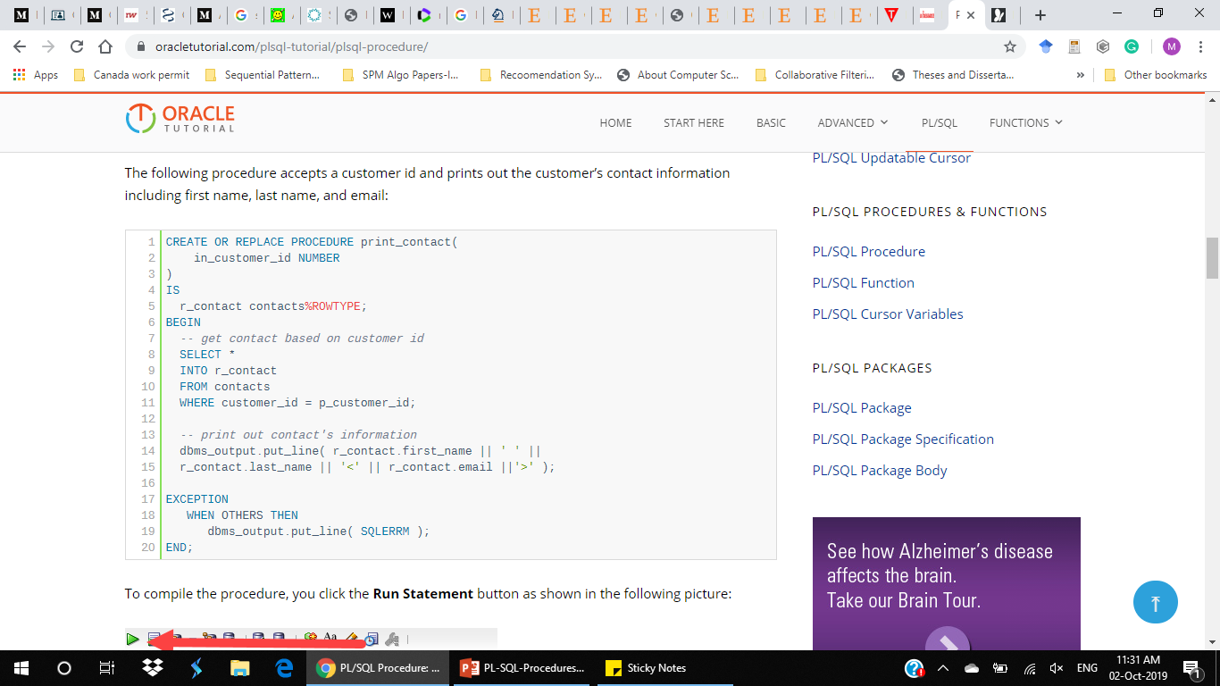
PL/SQL procedure –Step1 –Creating a Procedure
The following procedure accepts a customer id and prints out the customer’s contact information including first name, last name, and email:
p

Slide 10
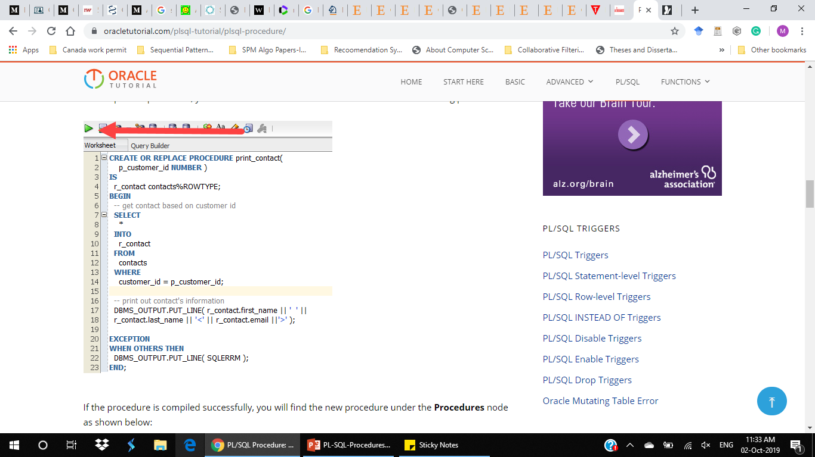
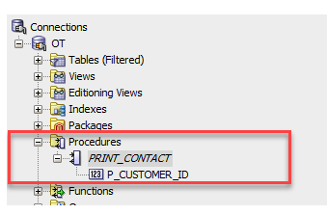
PL/SQL procedure –Step 2- Compiling
To compile the procedure, you click the Run Statement button as shown in the following picture:
Sucessful compilation

Slide 11
PL/SQL PROCEDURE –Step 3- Executing
Syntax:
1 | EXECUTE procedure_name( arguments);
Or
1 | EXEC procedure_name( arguments);
For example, to execute the print_contact procedure that prints the contact information of customer id 100, you use the following statement:
1 | EXEC print_contact(100);
Here is the output:
1 | Elisha Lloyd<elisha.lloyd@verizon.com>

Slide 12
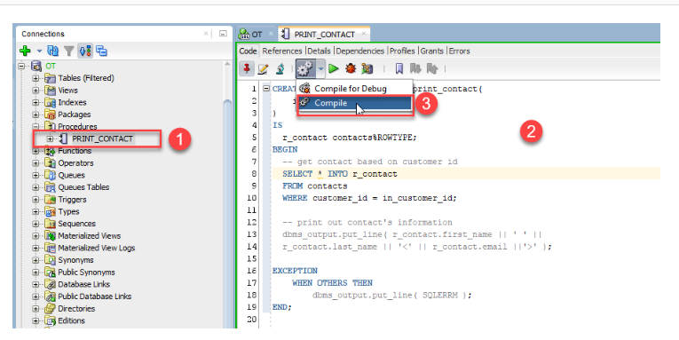
Editing a Procedure
To change the code of an existing procedure, you can follow these steps:
Step 1. Click the procedure name under Procedures node
Step 2. Edit the code of the procedure
Step 3. Click Compile menu option to recompile the procedure

Slide 13
Removing a Procedure
To delete a procedure, you use the DROP PROCEDURE followed by the procedure’s name that you want to drop as shown in the following syntax:
1 | DROP PROCEDURE procedure_name;
For example, the following statement drops the print_contact procedure :
1 | DROP PROCEDURE print_contact;

Slide 14
FUNCTIONS
A PL/SQL function is a reusable program unit stored as a schema object in the Oracle Database. The following illustrates the syntax for creating a function:
1 2 3 4 5 6 7 8 9 | CREATE [OR REPLACE] FUNCTION function_name (parameter_list) RETURN return_type IS [declarative section] BEGIN [executable section] [EXCEPTION] [exception-handling section] END;

Slide 15
FUNCTION-Header
A function consists of a header and body
The function header has the function name and a RETURN clause that specifies the datatype of the returned value
Each parameter of the function can be either in the IN, OUT, or INOUT mode

Slide 16
FUNCTION-BODY
The function body has three sections: declarative section, executable section, and exception-handling section
The declarative section is between the IS and BEGIN keywords
declare variables, constants, cursors, and user-defined types.
The executable section is between the BEGIN and END keywords
place the executable statements
Unlike a procedure, you must have at least one RETURN statement in the executable statement.
The exception-handling section is where you put the exception handler code.

Slide 17
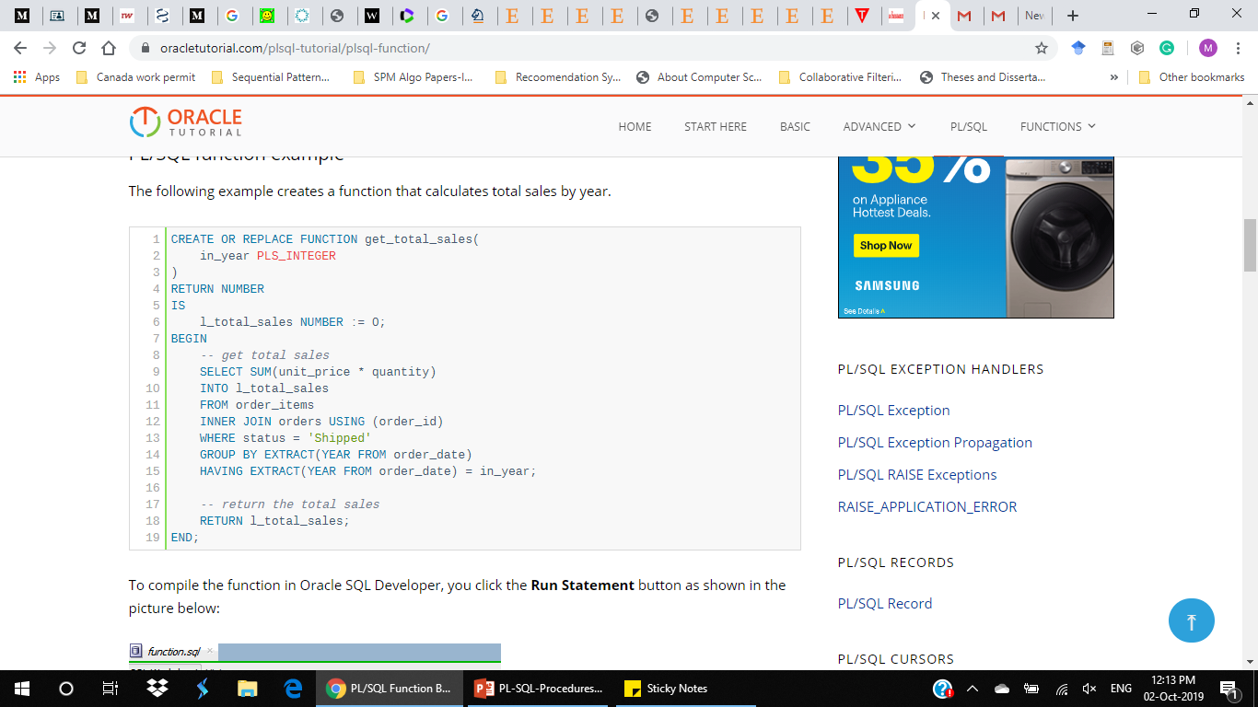
PL/SQL FUNCTION-Example
The following example creates a function that calculates total sales by year.

Slide 18
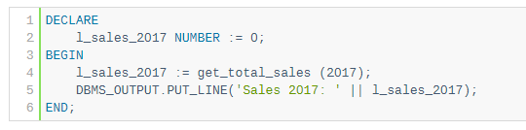

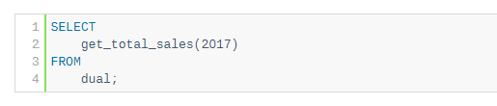
Calling a PL/SQL Function
You use a function anywhere that you use an expression of the same type. You can call a function in various places such as:
1) In an assignment statement
2) in a Boolean expression
3) in an SQL statement

Slide 19
Removing a Function
The DROP FUNCTION deletes a function from the Oracle Database. The syntax for removing a function is :
1 | DROP FUNCTION function_name;
For example, the following statement drops the GET_TOTAL_SALES function:
1 | DROP FUNCTION get_total_sales;
Oracle issued a message indicating that the function GET_TOTAL_SALES has been dropped:
1 | Function GET_TOTAL_SALES dropped.

Slide 20
PL/SQL Packages

Slide 21
PL/SQL Packages
PL/SQL Package
PL/SQL Package Specification
PL/SQL Package Body

Slide 22
PL/SQL Package
In PL/SQL, a package is a schema object that contains definitions for a group of related functionalities.
A package includes variables, constants, cursors, exceptions, procedures, functions, and subprograms.
It is compiled and stored in the Oracle Database.
A package has a specification and a body
A package specification is mandatory while the package body can be required or optional, depending on the package specification.

Slide 23
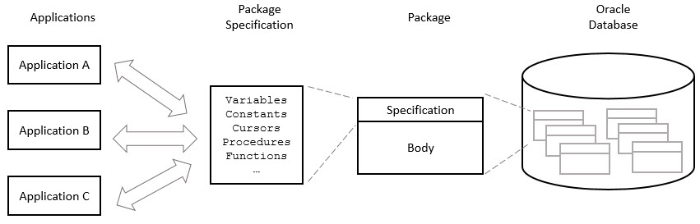
The following picture illustrates PL/SQL packages:

Slide 24
Package Specification & Body
The package specification declares the public objects that are accessible from outside the package
If a package specification whose public objects include cursors and subprograms, then it must have a body which defines queries for the cursors and code for the subprograms.
Package body
A package body contains the implementation of the cursors or subprograms declared in the package specification.
In the package body, you can declare or define private variables, cursors, etc., used only by package body itself.
A package body can also have an exception-handling part used to handle exceptions.

Slide 25
Why using PL/SQL packages ?
1) Make code more modular
Encapsulate logically related types, variables, constants, subprograms, cursors, and exceptions in named PL/SQL modules.
Each package more reusable, manageable, readable and reliable.
Hide implementation details
2) Hide implementation details
Expose the functionality via their specifications and hide the detailed implementation in the package body.
Enhance the code in the body of the package without affecting other dependent packages or applications.

Slide 26
Why using PL/SQL packages ?
3) Improve application performance
Oracle loads the package into memory at the first time you invoke a package subprogram.
The subsequent calls of other subprograms in the same package do not require disk I/O
4) Minimize unnecessary recompiling code
Packages help avoid the unnecessary recompiling process.
For instance, if you change the body of a package function, Oracle does not recompile the subprograms that use the function, because the subprograms are only dependent on the package specification, not the package body.

Slide 27
Why using PL/SQL packages ?
5) Manage authorization easily
By encapsulate objects in a package, you grant role on the package, instead of granting roles on each object in the package.

Slide 28
PL/SQL Package Specification
A PL/SQL package has two parts: package specification and package body.
The package specification is where you declare public items.
A package specification does not contain any implementations of the public items.
Typically, a package specification contains the following items:
Procedures
Functions
Cursors
Types, variables, and constants
Records
Collections

Slide 29
Creating a Package Specification
In this syntax:
Follow the CREATE PACKAGE clause is the name of the package which you want to create.
The OR REPLACE option allows you to replace the package if it exists and recompile it.
The schema_name is the schema to which the package belongs. By default, it is your schema
1 2 3 | CREATE [OR REPLACE] PACKAGE [schema_name.]<package_name> IS | AS declarations; END [<package_name>];
Between the AS and END keywords, you declare the public items of the package specification.

Slide 30
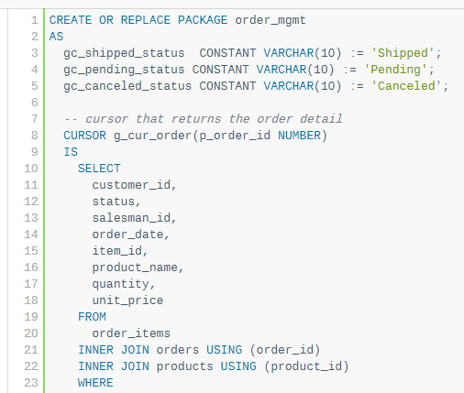
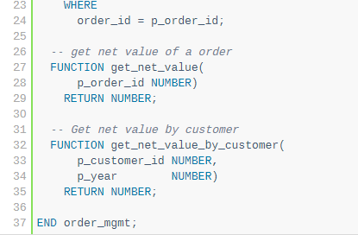
Package Specification-Example

Slide 31
Example Explanation
In this example, the package name is order_mgmt. Let’s examine it in detail:
First, we declared three constants that represent the order status: shipped, pending, and canceled.
Second, we defined a cursor that returns the order details.
Third, we declared two functions that return the net value of an order and the net value of orders which belong to a specific customer.

Slide 32
Compiling a Package
1 2 3 4 5 6 | SQL> create package test_package as 2 gc_status constant varchar(10) := 'Active'; 3 end; 4 / Package created.
In this example, the forward slash (/) instructed Oracle to compile and create the test_package package

Slide 33
PL/SQL Package Body
If the package specification has cursors or subprograms, then the package body is mandatory. Both the package body and package specification must be in the same schema
A package body can have an initialization part which consists of statements that initialize public variables and do other one-time setup tasks.
The initialization part only runs once at the first time the package is referenced. It can also include an exception handler.

Slide 34
Creating a Package Body
To create a package body, you use the CREATE PACKAGE BODY as shown below:
1 2 3 4 5 6 | CREATE [OR REPLACE] PACKAGE BODY [schema_name.]<package_name> IS | AS declarations implementations; [BEGIN EXCEPTION] END [<package_name>];
First, you specify the package name after the CREATE PACKAGE BODY keywords. The schema name is optional. By default, it is your schema.
Second, the OR REPLACE option replaces the existing package body definition or do nothing if the package body does not exist.
Third, between the AS and END keywords are the declarations of private items and the implementations of the public items declared in the package specification. Note that you can use either IS or AS keyword.

Slide 35
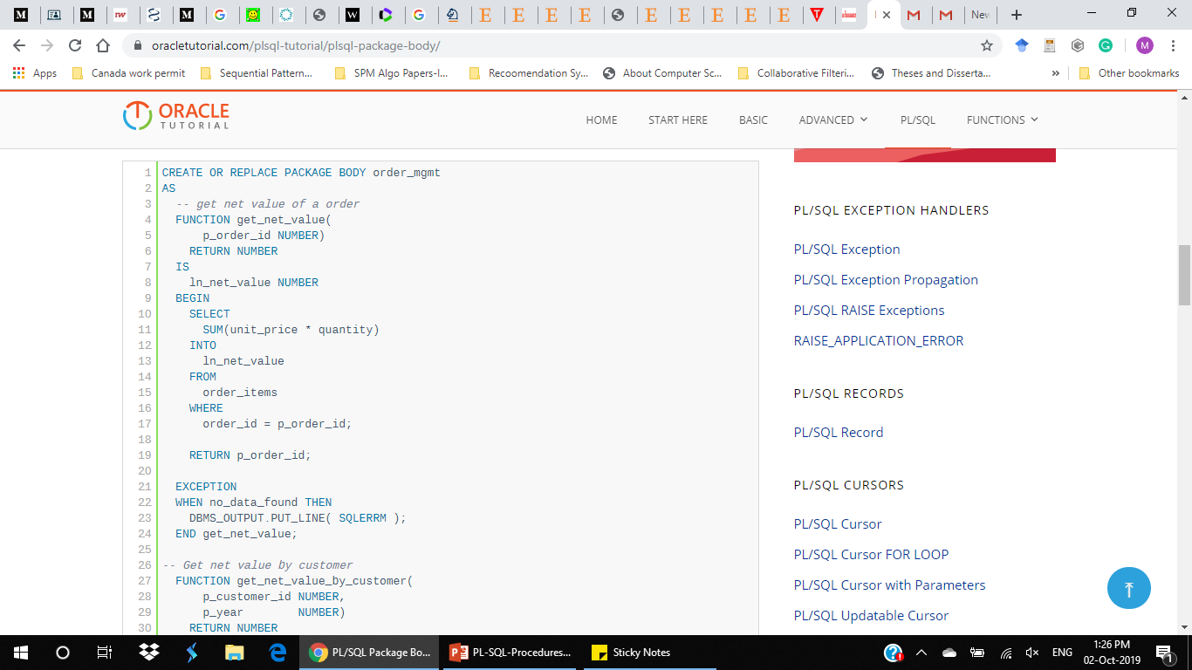
Creating a Package Body-Example
The following example illustrates how to create the body of the order_mgmt package:

Slide 36
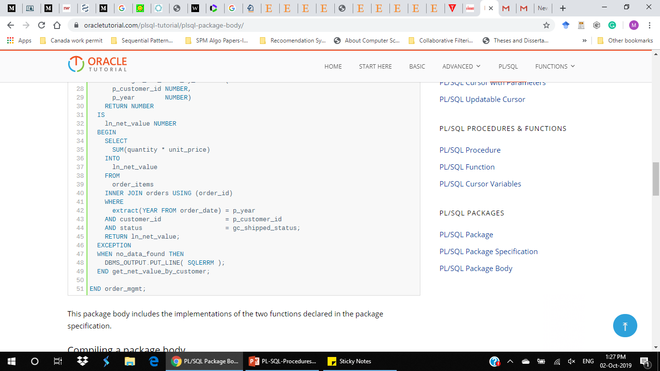
Example-Continued
This package body includes the implementations of the two functions declared in the package specification.

Slide 37
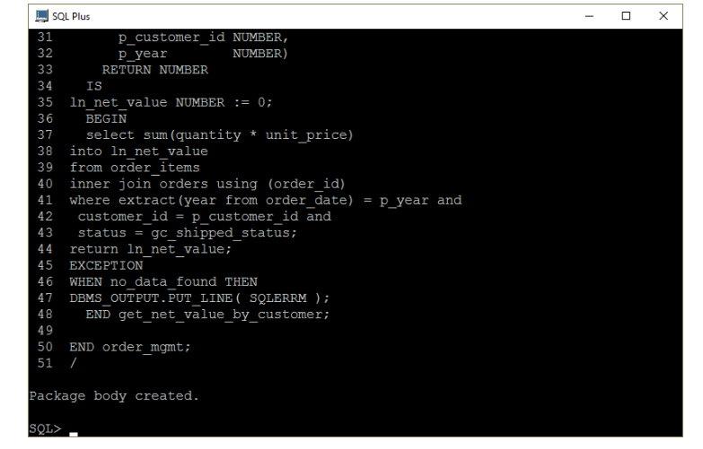
Compiling Package Body
type forward slash (/) as follows

Slide 38
DROP Package
To drop a package, you use the DROP PACKAGE statement with the following syntax:
1 | DROP PACKAGE [BODY] schema_name.package_name;
The following statement drops the package body of the package order_mgmt that we created in the previous tutorial.
1 | DROP PACKAGE BODY order_mgmt;
To drop both body and specification of the order_mgmt package, you use the following statement:
1 | DROP PACKAGE order_mgmt;

